Slide 1
MOBILE-ID TECHNOLOGIES AND SERVICES JOINT STOCK COMPANY

Slide 2
CONTENTS
1
COMPANY PROFILE
2
PRODUCTS & SERVICES
3
CUSTOMERS & PARTNERS

Slide 3
ABBREVIATION
FIDO: Fast Identify Online
MSSP: Mobile Signature Service Provider
VGCA: Vietnam Government Certification Authority
MIC: Ministry of Information and Communications
HOSE: Ho Chi Minh City Stock Exchange

Slide 4
COMPANY PROFILE
www.mobile-id.vn
2016: Established
Now
Feb, 2018: Trusted Hub procedure was licensed by MIC
Mar, 2018: Provided NRCA/LCA for Lao
Government
Oct, 2016: Joined FIDO
April, 2017: Trusted Hub got UAF Server Certificate
Nov, 2016: Trusted Hub got the Copyright from NOIP
Aug, 2017: Tested MSSP for VGCA

Slide 5
PRODUCTS & SERVICES
CORECA –
RA - TMS
TRUSTED HUB
MOBILE-ID™
SMART-ID
eSIGNCLOUD
MOBILE-ID

Slide 6
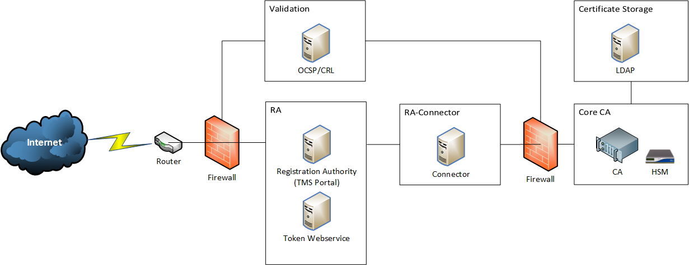
PRODUCTS & SERVICES
CA-RA-TMS SOLUTION
https://www.mobile-id.vn:9085/RegistrationAuthorityV2/

Slide 7
PRODUCTS & SERVICES
CA-RA-TMS SOLUTION
https://www.mobile-id.vn:8443/RegistrationAuthority/
OVERVIEW
CA Management (SHA1 CA, SHA2 CA)
Agency Management (Requestor, Approver, Administer and Accountant)
CA User Management
Certification Lifecycle Management
Token Lifecycle Management
Reconciliation on token/certification operation
Self-service with Usertool feature
Log management to technical issue report
FEATURE
High Available
Ready for Customization
Innovative User Self-Service Facilities
Open standard architecture
Plugin-Play support

Slide 8
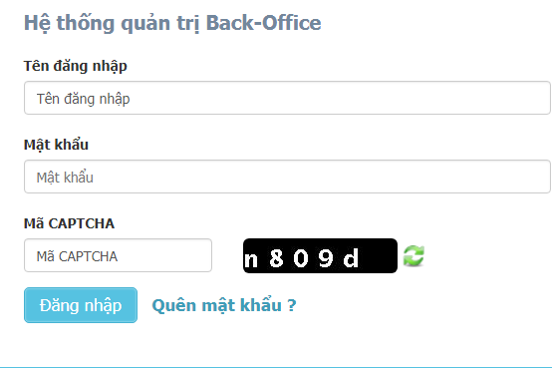
PRODUCTS & SERVICES
TRUSTED HUB SOLUTION
www.trusted-hub.com

Slide 9
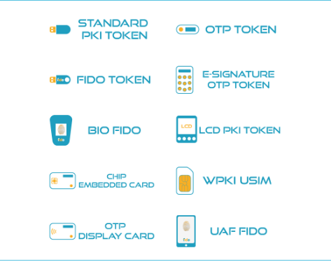



PRODUCTS & SERVICES
CONTACT US
+84 28 3636 6015
info@mobile-id.vn
Mobile-ID Helpdesk
TRUSTED HUB SOLUTION
www.trusted-hub.com

Slide 10
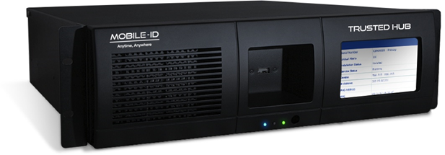







PRODUCTS & SERVICES
TRUSTED HUB MINI APPLIANCE
http://mobile-id.vn/TrustedHub/
Sign
The trusted private and hybrid cloud signing solution
Integrate
Maximum security and enforceability
Highest levels of compliance
Install
Transform your organization without disrupting it

Slide 11
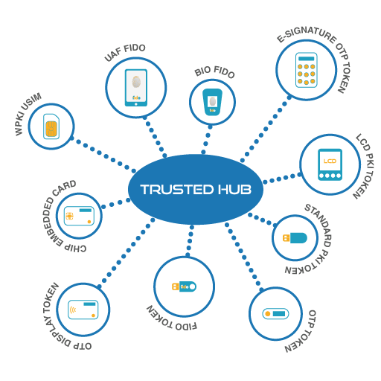
PRODUCTS & SERVICES
TRUSTED HUB MiniHSM APPLIANCE
http://mobile-id.vn/TrustedHub/
A New Generation Secured Unified Authentication Gateway with Adaptive Intelligence
Trusted Hub
Adaptive Intelligence works based on the combination of user’s previous login data and rules defined by the systems.

Slide 12
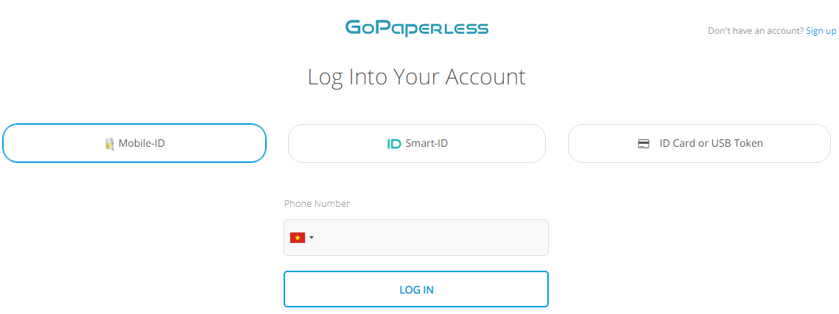
PRODUCTS & SERVICES
GOPAPERLESS – www.gopaperless.vn

Slide 13
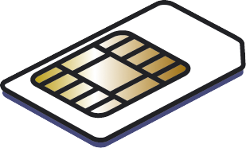




PRODUCTS & SERVICES
MOBILE-ID – www.mobile-id.vn
SIM
Server
Request for digital signature
Request for digital signature from the service provider
Ví dụ:
«transfer confirmation for Ms Lan 500$»
(GSM 03.48)
transfer confirmation for Ms Lan 500$
transfer confirmation for Ms Lan 500$
Receive & show SMS
Transaction received
Enter PIN
Message Hash (SHA)
52ED879E….
Message Hash (SHA)
52ED879E….
Digital Signaute (RSA)
XXXXXXX….
Compare 2 hash strings. If match, the digital signature is invalid
?
Encrypted SMS
CA
SIM send digital signature + « PuK ID » to server by SMS
Signed Hash
Certificate
Or CertID
Or PuK ID
52ED879E….
Public Key ID
(GSM 03.48)
XXXXXXX….
Get lock information & decryption
Public Key

Slide 14
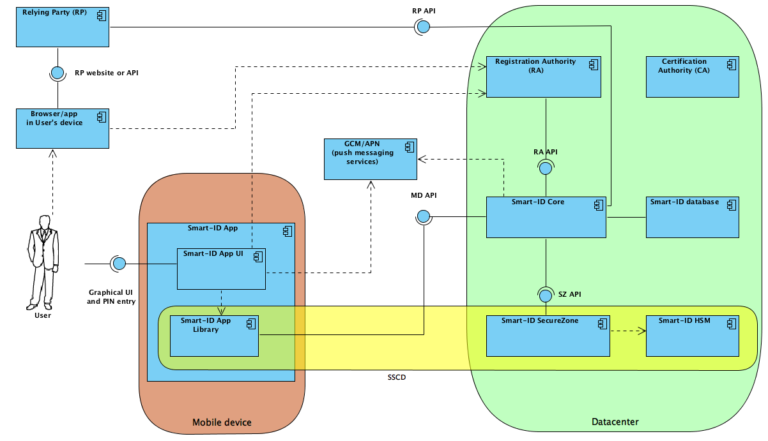
PRODUCTS & SERVICES
SMART-ID – www.smart-id.vn

Slide 15

PRODUCTS & SERVICES
eSIGNCLOUD – https://gopaperless.vn/eSignCloud/

Slide 16
CUSTOMERS & PARTNERS
MOBILE-ID™
CUSTOMERS
▪ FINANCE
▪ BANKING
▪ TELCO
PARTNERS

Slide 17







CUSTOMERS & PARTNERS
CUSTOMERS (CERTIFICATE AUTHORITY)

Slide 18










CUSTOMERS & PARTNERS
CUSTOMERS (FINANCIAL)

Slide 19




CUSTOMERS & PARTNERS
CUSTOMERS (TELCO)

Slide 20





CUSTOMERS & PARTNERS
CUSTOMERS (OTHERS)

Slide 21










CUSTOMERS & PARTNERS
PARTNERS

Slide 22


Slide 23




THANK YOU!
Any Questions?
You can find me at:
Mobile-ID Technologies Services Joint Stock Company
43 Mac Dinh Chi, District 1st, HCMC, Vietnam
(84-28) 3636 6015 - Hotline: 19006884
info@mobile-id.vn
http://www.mobile-id.vn

